Slide 1
Pharmacy drug interaction tool

Slide 2
AGENDA
Overview
Problem Statement
Target Market
Assumptions
Solution

Slide 3
Overview
Key Objectives
Potential Scenarios
Enhance clinical decision-making
Improve patient safety
Act as an educational tool for students
Can potassium from bananas interfere with prescribed medications?
Would the consumption of St. John’s Wort with certain medications cause toxicity?
Notes:
Enhance clinical decision-making by providing quick, reliable information on drug interactions.
Improve patient safety by helping pharmacists identify potential risks, such as toxicity or reduced drug efficacy.
Serve as an educational tool for students to learn about real-world scenarios involving medication management.
Detecting if potassium from bananas could interfere with prescribed medications, such as ACE inhibitors.
Highlighting the risk of St. John’s Wort interacting with medications like antidepressants, leading to potential toxicity.

Slide 4

Problem statement

Slide 5
Potential risks
Mismanagement of drug interactions can result in:
Adverse effects
Patient safety concerns
Reduced drug effectiveness
Promote non-adherence
Ethical concerns
Notes:
Adverse Effects: Toxicity, reduced drug efficacy, or unintended side effects.
Patient Safety Issues: Compromised health outcomes and increased liability.
Certain foods and herbal supplements can reduce a medication’s effectiveness.
Example: Dairy + Antibiotics (Tetracyclines, Ciprofloxacin) → Decreased absorption, making the antibiotic less effective.
Patients may unintentionally worsen their condition by consuming food or supplements that interact negatively with their medication.
Example: St. John’s Wort + Antidepressants → Can lead to serotonin syndrome, a life-threatening condition.
Pharmacists and healthcare professionals have a duty of care to prevent harmful interactions.
Lack of knowledge or failure to warn patients can lead to medical malpractice claims or ethical dilemmas.

Slide 6
how do you guide your patients when prescribing medications to ensure they are aware of potential interactions with common foods, fruits, or dietary habits?
“As a doctor I would guide my patients about the medication interactions with foods, fruits or dietary habits is crucial for their safety and well being. Out give a pre- prescription counselling which help in assessment of dietary habits of a patient by typical diets including foods, daily consumption regularly or any other products, review their medication interactions potential interactions between prescribed medications, provided guidance on medication potential interactions and of a tailor advice on managing them I would recommend a regular check up of patient potassium levels especially if they are taking medications potassium sparing diuretics or any potassium contents fruits, and it's correct intake so the patient won't be in the risk of excessive potassium intake also would recommend a moderate balance diet.
Will suggest a lower potassium contains or supplements
If the patient is taking potassium supplements I would strongly advise them to avoid taking St. John's worts or any other supplements as they can increase toxicity or reduce the efficiency of prescribed medication.”
Dr. Bhaskar Jyoti Konwar
SJNH Medical College & Hospital
Notes:
And to further emphasise upon the importance of considering drug-food interactions, we had interviewed a friend of bhargav’s, who happens to be a Doctor. While the response in courtesy of him is lengthy, it essentially outlines that educating the patients about the interactions that may be present based on their diet plan and guiding them accordingly is of utmost priority. Taking it back to St. John’s worts again, Dr. Bhaskar Jyoti has described the dangers associated with faulty consumption habits.

Slide 7
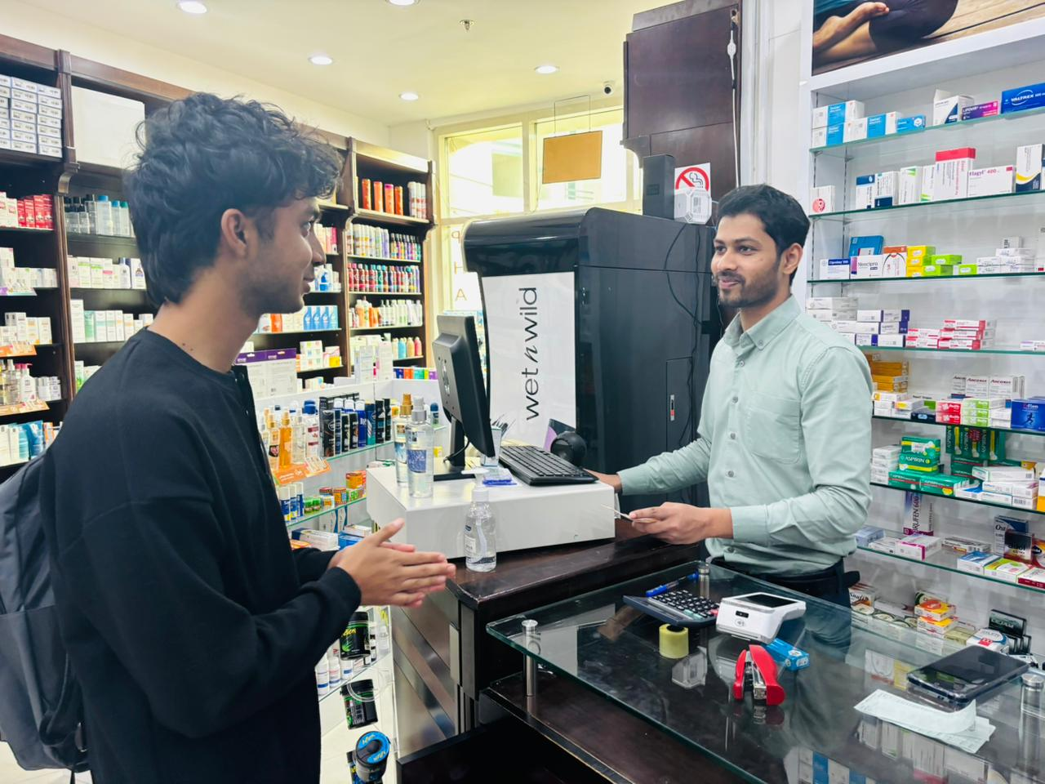
Pharmacist interview insights
Key Points Derived
Foods can affect the absorption of medications
Drug-food interactions can lead to ineffective treatment
Educating patients on medications is a necessity
Timing of a dose does matter
A case where medication with grapefruit juice led to high drug levels
Notes:
Food can affect the absorption of medications by altering stomach pH or interfering with the enzymes responsible for drug metabolism.
Failing to account for drug-food interactions can lead to ineffective treatment or even dangerous side effects, like gastrointestinal issues or blood pressure changes.
It's essential to counsel patients on the appropriate manner to take medications, especially when food may alter their effectiveness.
Some medications should be taken on an empty stomach to ensure proper absorption, while others may be better absorbed with food to avoid irritation. Adjusting the timing of a dose based on meals can help ensure the drug works as intended.
A case where a patient unknowingly combined their medication with grapefruit juice led to dangerously high drug levels, demonstrating how easily interactions can occur without proper education.

Slide 8
Target market
Notes:
Encapsulating all that we’ve considered so far, and we had briefly hinted at this earlier in the slides too BUT our target market lies with two groups of audience.

Slide 9
Student pharmacists
Complexity
Learning Challenges
Understanding drug interactions can be overwhelming
Lack of accessible resources
Lack of practical exposure
Theoretical knowledge challenges
Notes:
Starting off with student pharmacists, there are various problems that this group in particular experiences. Namely the complexity, where:
Understanding drug interactions with alternative medicines, supplements, and food can be overwhelming for student pharmacists.
Lack of easily accessible resources to provide quick guidance during placements.
In addition to that, students are posed with learning challenges
Limited practical exposure to real-world drug interaction scenarios.
Difficulty connecting theoretical knowledge with real-time decision-making during placements.

Slide 10
Patients
Lack of Knowledge and Awareness
Affected Compliance
Drug-food interactions deemed minimal
Misleading beliefs
Delayed detection of interactions
Inconsistent adherence
Notes:
And then we’ve got our second group, the patients, who happen to be prone to a lack of knowledge, which leads to:
Unaware of food interactions: Patients may not realize certain foods can affect their medications.
Misleading beliefs about 'natural' foods: Assuming natural foods or supplements are always safe without considering interactions.
Moreover, compliance is affected as:
Delayed detection of interactions: Some drug-food interactions may not cause immediate symptoms, and patients may not recognize the long-term negative effects on their health.
Inconsistent adherence to instructions: Patients may not always follow the prescribed instructions for food and medication timing, leading to inconsistent therapeutic outcomes.
Encapsulating the struggles faced by our target market in here, we had reached a number of assumptions (next slide)

Slide 11

Assumptions
General public lacks sufficient knowledge of drug-food interactions
Internet resources play vital role for guidance
Patients generally trust pharmacists
Knowledge gaps are prevalent
Notes:
Which are as follows.

Slide 12
Statistics
QUESTION | YES | NO
Have you wondered if the food you eat can interact with medications? | 69% | 31%
Do you check whether any form of interaction is present? | 51.7% | 48.3%
Have you encountered a situation where a patient’s diet affected their treatment outcome? | 53.6% | 46.4%
Do you know if the potassium in bananas can interfere with certain medications? | 32.1% | 67.9%
If a management tool existed, would you use it to identify food-drug interactions? | 65.5% | 34.5%
Acquired 29 responses
Data obtained pertains to:
Public awareness
Experiences
Acceptability

Slide 13
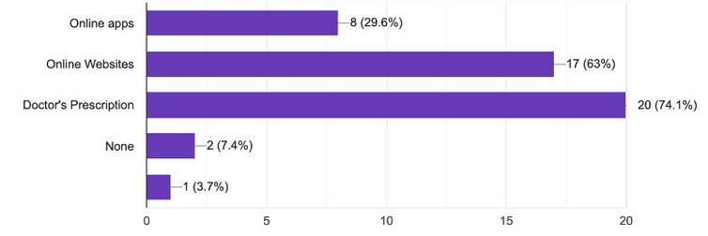
Most utilized resources

Slide 14
Solution
A reliable, light-weight tool for drug interactions.
User-friendly Interface
Enhance learning
Ensure patient safety

Slide 15
THANK YOU
Participants:
Bhargav Raj Dutta
Muhammed Zayid Hasher
Gilchrist Candido Tavares
Saihan Shafique Pardesi

